Slide 1
60 Seconds
By: Aaron Scofield, Ryan Hardison, Xu Lyu, Zachary Preston, Zack Waxler
Notes:
Ryan

Slide 2
Scope of the Project
Feature List
A mobile/web application that bridges the gap between existing personal journaling applications and the medium of audio.
The product notifies users each day to record their audio journal entry.
These daily audio journal entries will be able to be parsed through in a calendar format, providing users with an easily retrospective narration of their life.
Recording audio
Audio playback
Daily reminder notifications
Backend server to coordinate
Tagging and highlighting of recordings
Intuitive organizational and accessing of recordings
cloud storage of audio clips
Frontend website to record clips and access them
Zachary William Preston

Slide 3

User Story (Sarah)
Zachary William Preston
Sarah is a college student in her early 20’s. In 2022, her New Year’s Resolution is to get into shape. As she embarks on her fitness journey, she wants recall her journey, similar to posting pictures on Instagram; she wants to briefly document the day to day experiences.
60 seconds will make this possible for her. Every day she will provide a brief narration of her daily accomplishment. Over time, her journalistic portfolio will expand. Anytime during her progress, if her motivation wanes, she can revisit her previous entries, and provide words of encouragement (from her own
mouth) to maintain the grindset. Before long, she will have
achieved her new year’s resolution, making her 2022 the most
fulfilling year of her life.
Mon.
Tues.
Wed.
Thus.
Fri.

Slide 4

User Story (John)
John, 40, is a real estate agent who often meets with potential buyers. He uses the 60 Seconds app to keep track of important information that he gets from meetings with his clients. After each meeting, he records a small summary of what each client is looking for so he can reference it in the future without worrying about forgetting anything. He is then able to access all of the relevant information at the touch of a button from an easy to use interface in the 60 Seconds application.
Notes:
Zack

Slide 5

User Story #3 (Larry)
Larry, 27, is a hard-working Uber driver. Larry has had the habit of keeping a diary since he was a child. He wanted to record the number of orders he took in a day, the money he made and the interesting things he encountered during the day. He is so busy every day that he doesn't have time to sit down and write in his diary. He found a web app called 60 seconds. By using this app, he only needs to touch one button to make a voice diary anytime and anywhere. Over time, his voice diary fills up almost the entire calendar, he can easily review previous voice diaries and share these stories with his family.

Slide 6

User Story #4 (Jessica)
Jessica is a 26 year old who is currently a stay at home mom with her first born. Her daughter is at the age where she is starting to say her first words/phrases! She uses 60 Seconds to document the progress her daughter makes in her speaking to make a keepsake of her to share with friends and family on social media.
She began her 60 Seconds project within the first few days her daughter began speaking, recording for about 15 seconds each day with a max recording of 60 seconds (her daughter was feeling a bit chatty). She takes advantage of the calendar style organization to organize herself and navigate through the recordings and star her favorite ones. When she feels like sharing she selects which dates to share and downloads the .mp3 file.
Notes:
Ryan

Slide 7

User Story #5 (Jake)
Jake, 30, is a full-time musician, and loves writing new songs. He often finds himself with new ideas for songs while he is playing his guitar, but struggles to quickly record and document these ideas before he forgets them.
When Jake has a fleeting idea for a song, he can open the 60 Seconds app on his phone and quickly begin recording a demo. He gives the recording a title, adds an organizational tag or two, and is able to move on with his songwriting process.
60 Seconds makes Jake’s life much easier, and allows him to easily record short snippets of his song demos and organize them effectively to access again later.
Notes:
Aaron

Slide 8
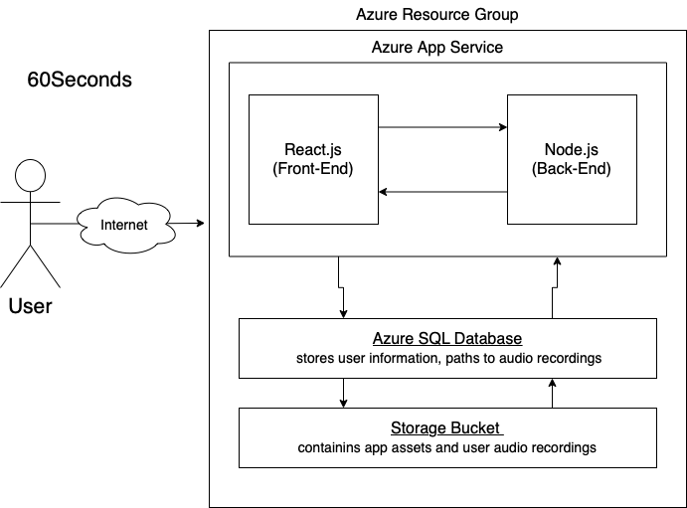
System Block Diagram
Notes:
Ryan

